Slide 1


GBME Probability and Statistics | Fall 2018
Lecture 05 | 091718
Lecture 05
Scatterplots & Correlation
CHOONG-WAN WOO | COCOAN lab | http://cocoanlab.github.io

Slide 2
Lecture 05 | 091718
Review: Key Points
Chapter 5: Comparing distributions
Outliers are context dependent
Timeplots
Moving-averages, smoothing
Re-expressing data (log, sqrt)
to improve symmetry
to equalize spread
Chapter 6: Normal model
z-score, shifting and rescaling
Normal model,
Normality assumption; unimodal, symmetric
68-95-99.7 Rule
z-to-p, p-to-z
Normal probability plots
CHOONG-WAN WOO | COCOAN lab | http://cocoanlab.github.io

Slide 3
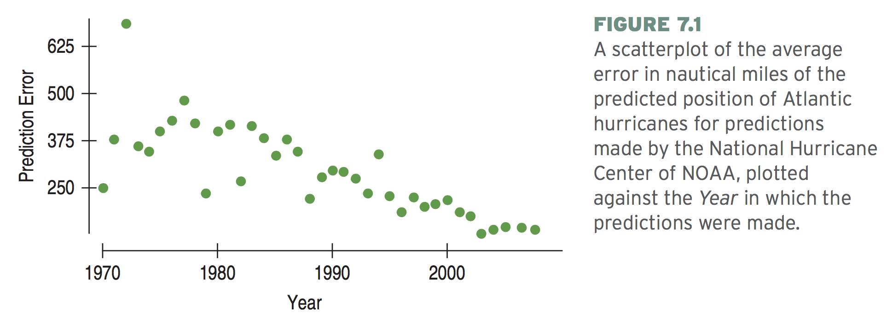
Lecture 05 | 091718
Scatterplots
Dots to show the relationship between two variables
Most common display for data
“You can observe a lot just by watching”, Yogi Berra
CHOONG-WAN WOO | COCOAN lab | http://cocoanlab.github.io

Slide 4
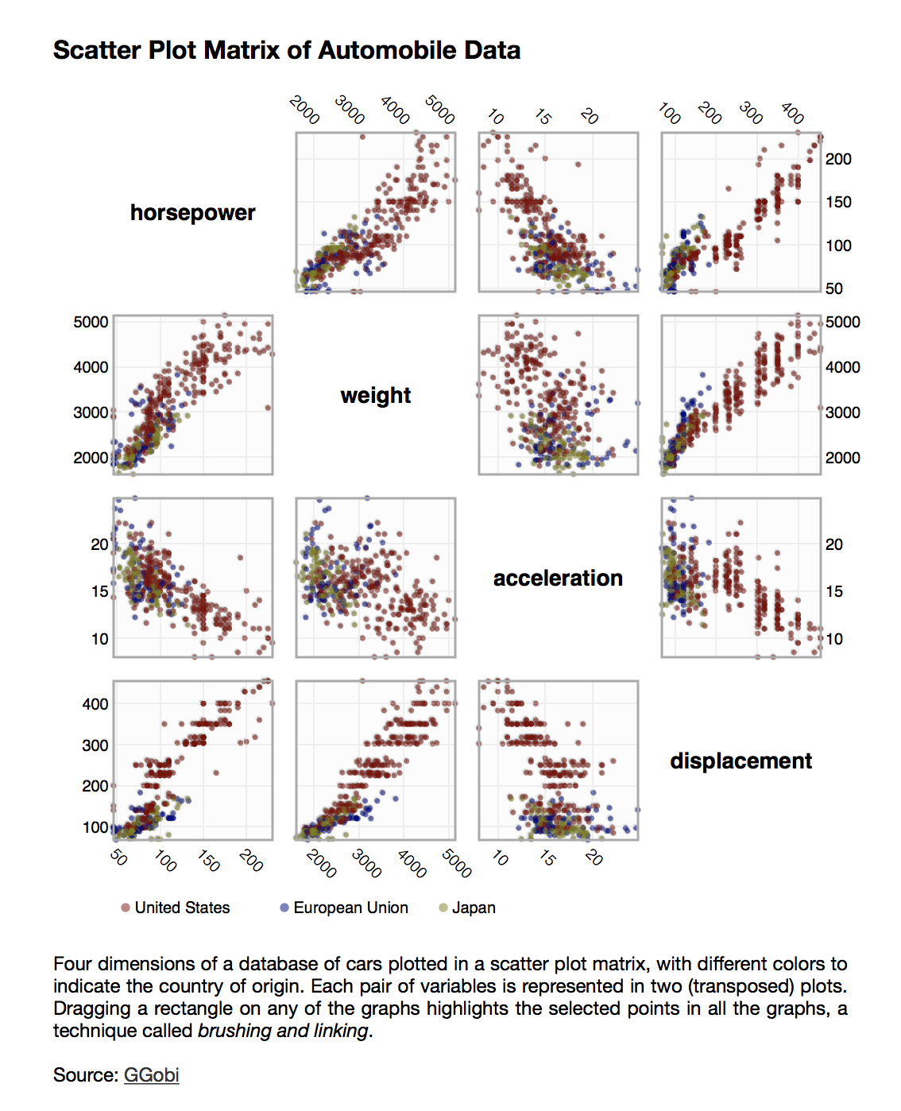
Lecture 05 | 091718
Scatterplots
Displaying multiple attributes
https://homes.cs.washington.edu/~jheer//files/zoo/ex/stats/splom.html
Cool webpage for data visualization:
https://homes.cs.washington.edu/~jheer//files/zoo/
CHOONG-WAN WOO | COCOAN lab | http://cocoanlab.github.io

Slide 5
Lecture 05 | 091718
Scatterplots
When examining the scatter plot, be sure to study the:
Direction: “What’s my sign—positive, negative, or neither?”
Form: “Straight, curved, something exotic, or no pattern at all?”
Strength: “How much scatter?”
Outliers: “Are there outliers or subgroups?”
CHOONG-WAN WOO | COCOAN lab | http://cocoanlab.github.io

Slide 6
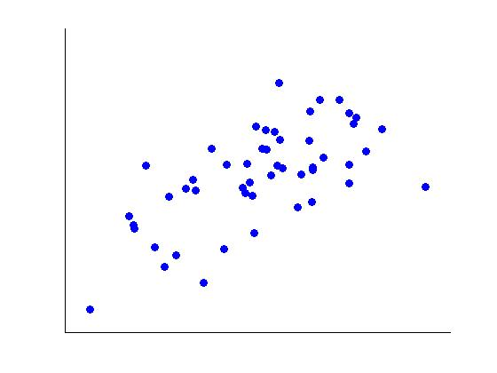
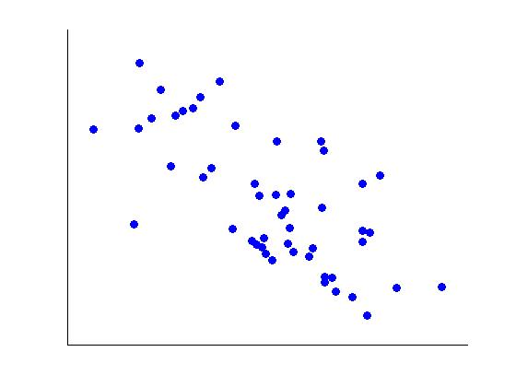
Lecture 05 | 091718
Scatterplots: Direction
(a) Positive association
As x increases, y increases.
(b) Negative association
As x increases, y decreases.
Slide credit: Martin Lindquist
CHOONG-WAN WOO | COCOAN lab | http://cocoanlab.github.io

Slide 7
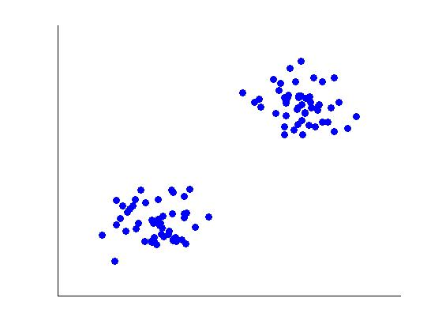
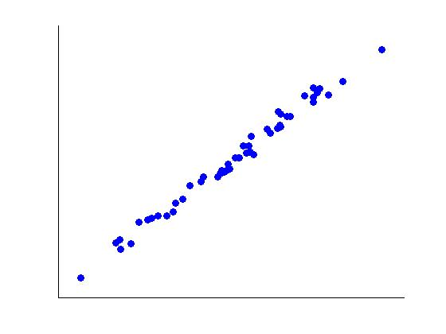
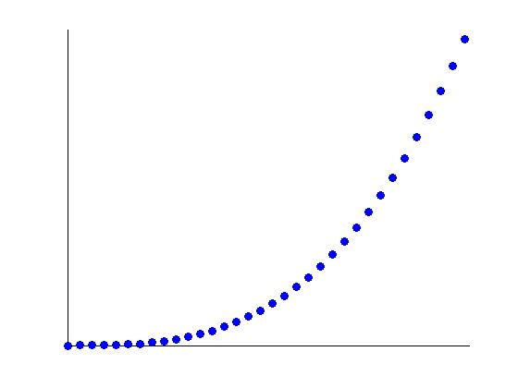
Lecture 05 | 091718
Scatterplots: Form
What does the data look like? Is the data clustered together, does the data have a linear shape or a curved shape.
Clustered
Linear
Curved
Slide credit: Martin Lindquist
CHOONG-WAN WOO | COCOAN lab | http://cocoanlab.github.io

Slide 8
Lecture 05 | 091718
Scatterplots: Strength
How closely do the points follow a clear form?
Slide credit: Martin Lindquist
CHOONG-WAN WOO | COCOAN lab | http://cocoanlab.github.io

Slide 9
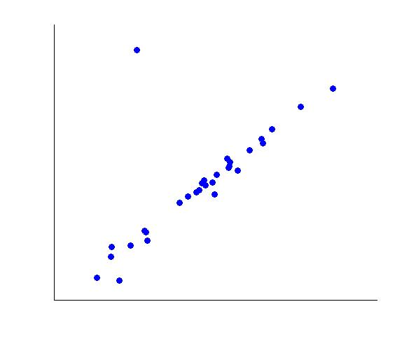
Lecture 05 | 091718
Scatterplots: Outliers
Outliers can be determined from a graph by looking for points that are not within the overall pattern of the data.
Slide credit: Martin Lindquist
CHOONG-WAN WOO | COCOAN lab | http://cocoanlab.github.io

Slide 10
Lecture 05 | 091718
Roles for variables
Do baseball teams that score more runs sell more tickets to their games?
Each data point: team, x: score, y: tickets they sell
Do older houses sell for less than newer ones of comparable size and quality?
Each data point: houses with similar size and quality, x: age, y: the price of the house
Do students who score higher on their SAT tests have higher grade point averages in college?
Each data point: students, x: SAT scores, y: GPA in college
Can we estimate a person’s percent body fat more simply by just measuring waist or wrist size?
Each data point: person, x: percent body fat, y: waist (or wrist size)
CHOONG-WAN WOO | COCOAN lab | http://cocoanlab.github.io

Slide 11
Lecture 05 | 091718
Roles for variables
x: explanatory variable, predictor variable, independent variable
y: the variable of interest, response variable, dependent variable
y-variable
x-variable
CHOONG-WAN WOO | COCOAN lab | http://cocoanlab.github.io

Slide 12
Lecture 05 | 091718
Linear relationships
If the form of the plot looks like a line, this indicates there may be a linear relationship between the two variables.
The relationship is strong if all the data points approximately make up a straight line.
It is weak if the points are widely scattered about the line.
Slide credit: Martin Lindquist
CHOONG-WAN WOO | COCOAN lab | http://cocoanlab.github.io

Slide 13
Lecture 05 | 091718
Correlation
We want a numerical summary that can be used to measure the strength of a linear relationship.
The correlation is a measure of strength and direction of a linear relationship between two quantitative variables.
Correlations are usually denoted by r.
Slide credit: Martin Lindquist
CHOONG-WAN WOO | COCOAN lab | http://cocoanlab.github.io

Slide 14
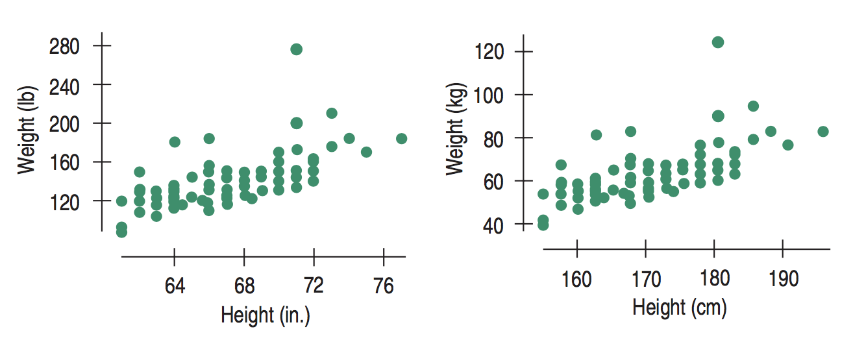
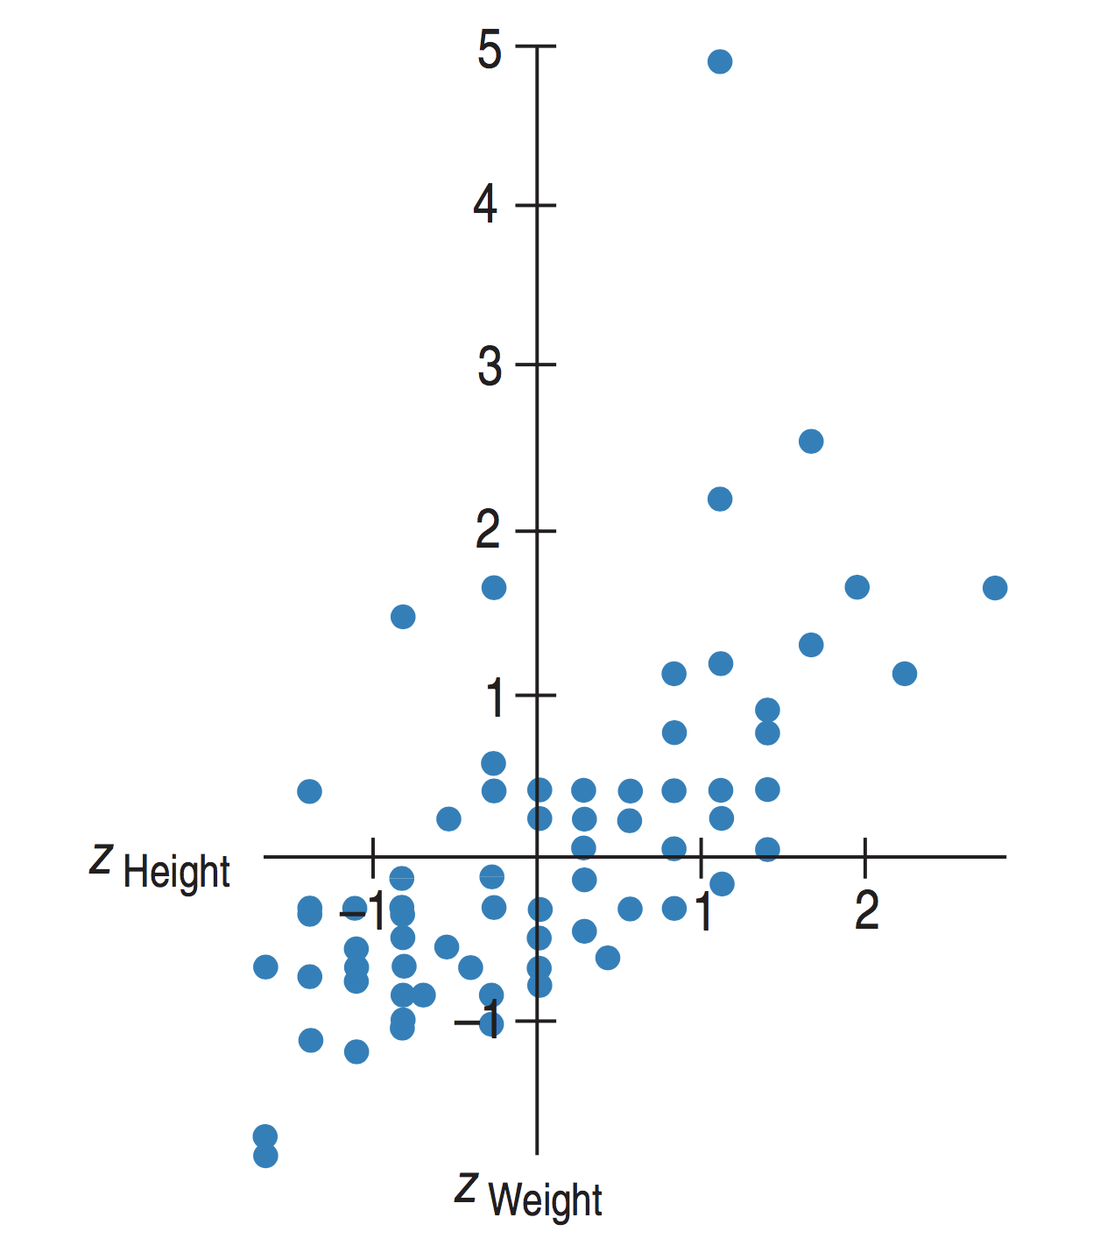
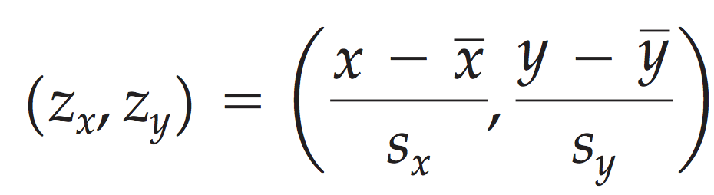
Lecture 05 | 091718
Correlation
The units should have no effects on our measure of strength of a linear relationship.
z-scores can be used:
CHOONG-WAN WOO | COCOAN lab | http://cocoanlab.github.io

Slide 15
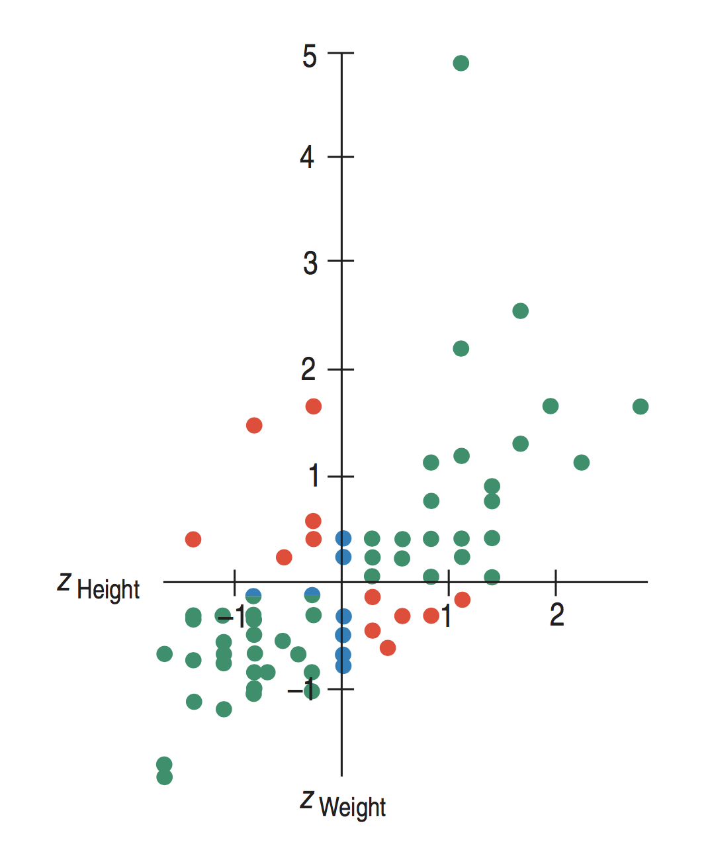
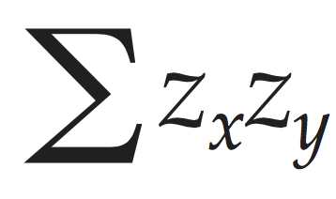
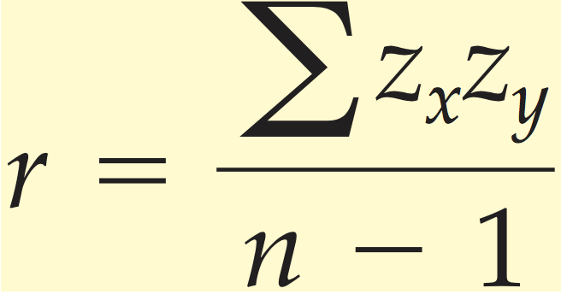
Lecture 05 | 091718
Correlation
Strength of linear relationship should be proportional to
Correlation coefficient:
, where
(+, +)
(-, -)
CHOONG-WAN WOO | COCOAN lab | http://cocoanlab.github.io

Slide 16
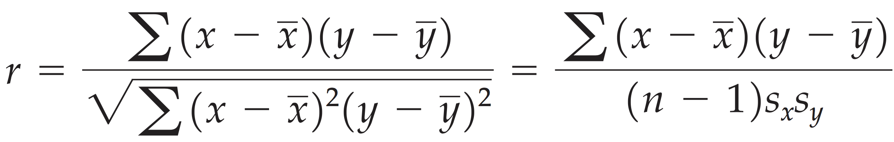
Lecture 05 | 091718
Correlation
Strength of linear relationship should be proportional to
Correlation coefficient:
, where
Different expressions, but mathematically same:
CHOONG-WAN WOO | COCOAN lab | http://cocoanlab.github.io

Slide 17
Lecture 05 | 091718
Assumptions and Conditions for Correlation
Quantitative variables condition
Straight enough condition
No outliers condition
Outliers can distort the correlation dramatically.
CHOONG-WAN WOO | COCOAN lab | http://cocoanlab.github.io

Slide 18
Lecture 05 | 091718
Properties of Correlation
Sign of correlation: the direction of the association (e.g., positive, negative)
Range: r is always between -1 and 1.
When r = 1 all of the points lie on a straight line with a positive slope.
r < 0 indicates a negative association.
When r = -1 all points lie on a straight line with negative slope.
If r is close to 0, this indicates a very weak linear relationship.
Symmetry: The correlation of x with y is the same as the correlation of y with x.
No units
The value of r does not change even if units of measure are changed.
The correlation has no unit of measurement.
Only linear: Correlation measures only the strength of a linear relationship.
Sensitive to outliers: The correlation is sensitive to outliers.
CHOONG-WAN WOO | COCOAN lab | http://cocoanlab.github.io
fisher’s r-to-z transformation

Slide 19
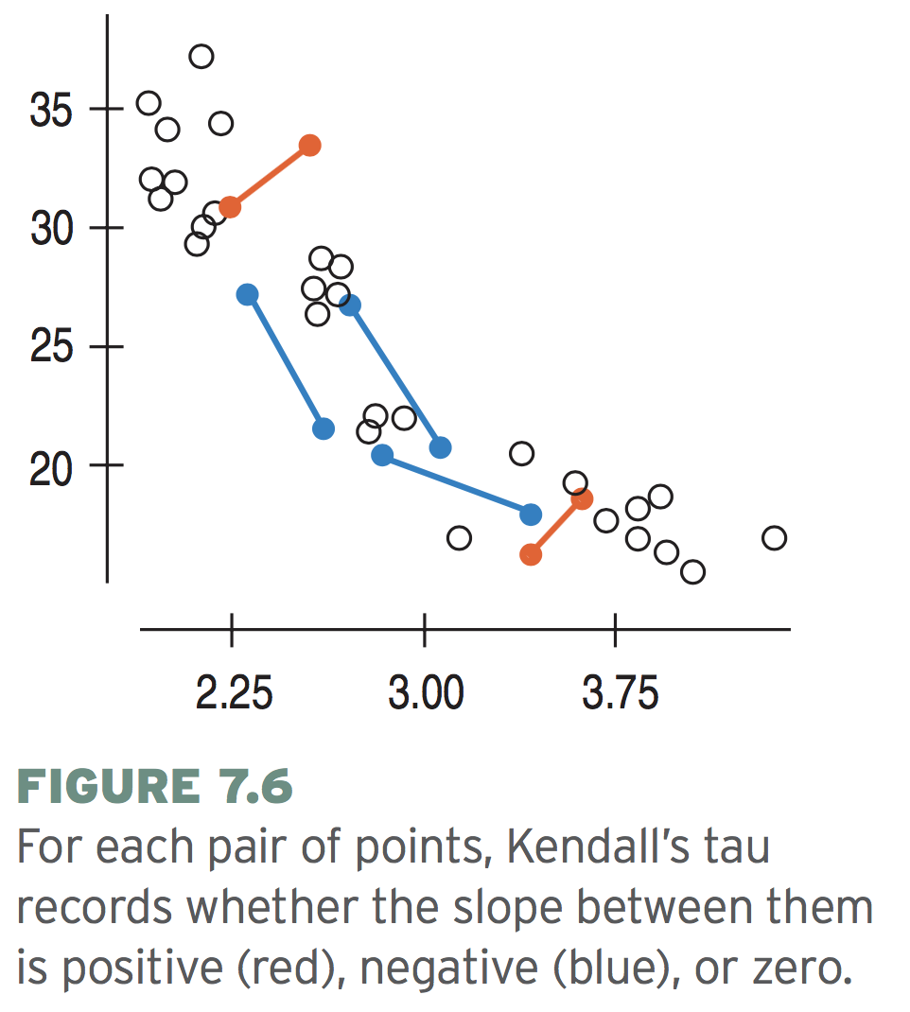
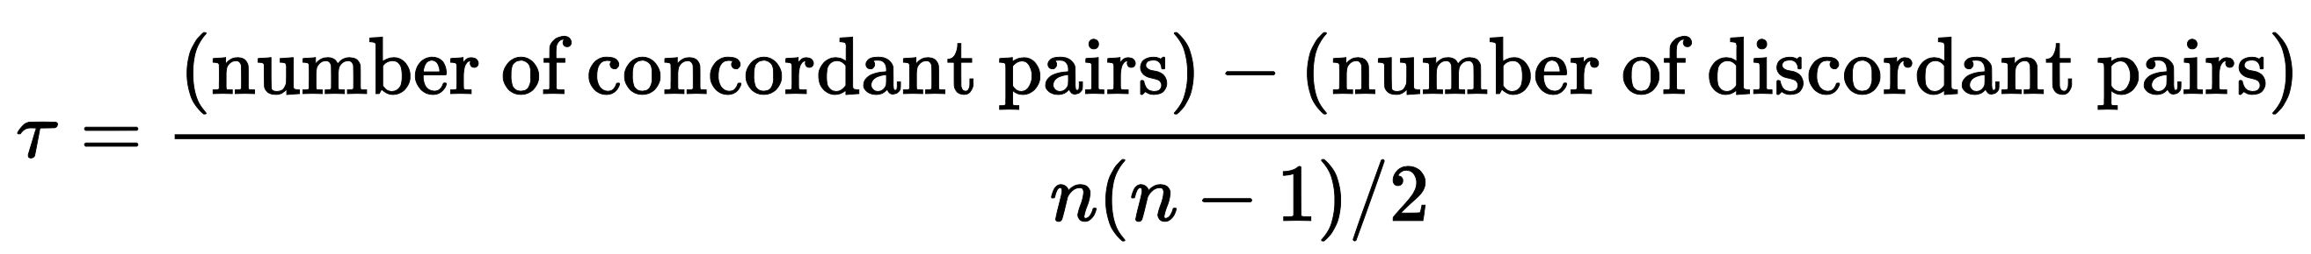
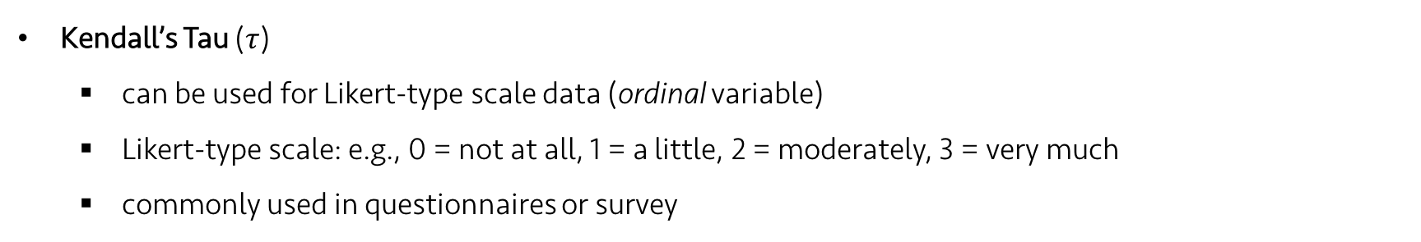
Lecture 05 | 091718
Other correlation measures (non-parametric):
Kendall’s Tau ($τ$)
can be used for Likert-type scale data (ordinal variable)
Likert-type scale: e.g., 0 = not at all, 1 = a little, 2 = moderately, 3 = very much
commonly used in questionnaires or survey
CHOONG-WAN WOO | COCOAN lab | http://cocoanlab.github.io

Slide 20
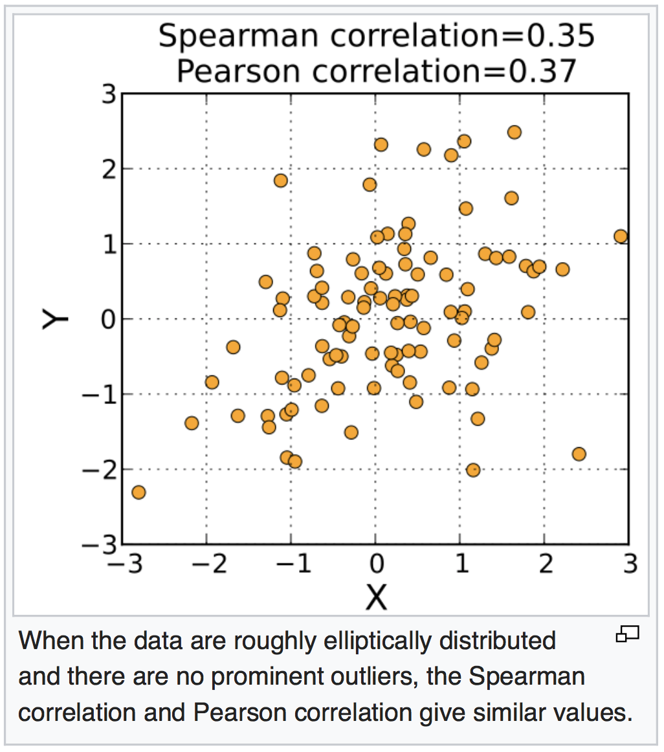
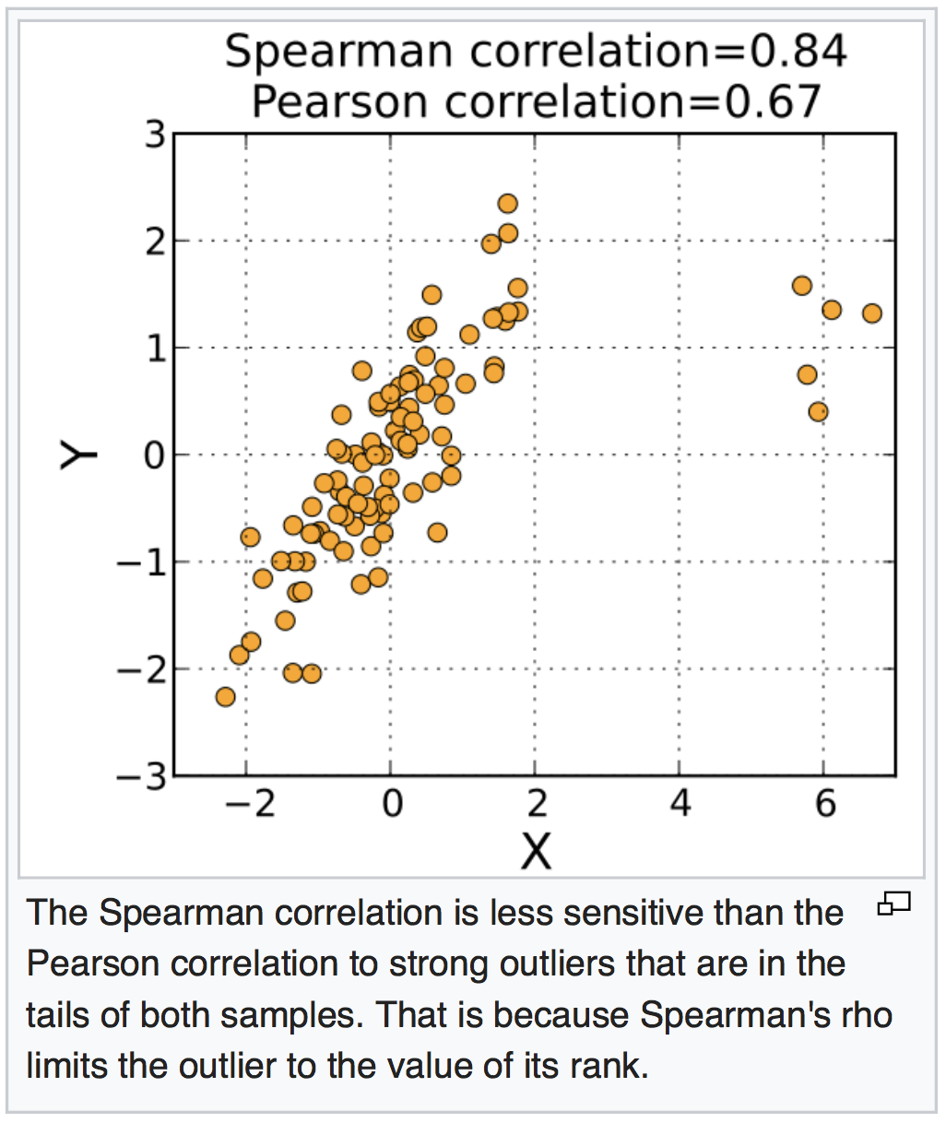
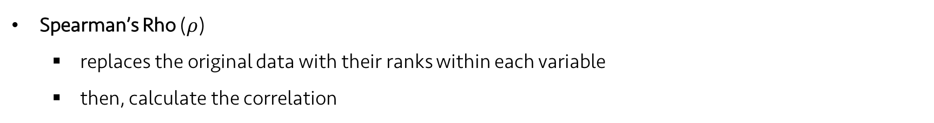
Lecture 05 | 091718
Other correlation measures (non-parametric):
Spearman’s Rho ($ρ$)
replaces the original data with their ranks within each variable
then, calculate the correlation
https://en.wikipedia.org/wiki/Spearman%27s_rank_correlation_coefficient
CHOONG-WAN WOO | COCOAN lab | http://cocoanlab.github.io
How to calculate spearman’s rho?

Slide 21
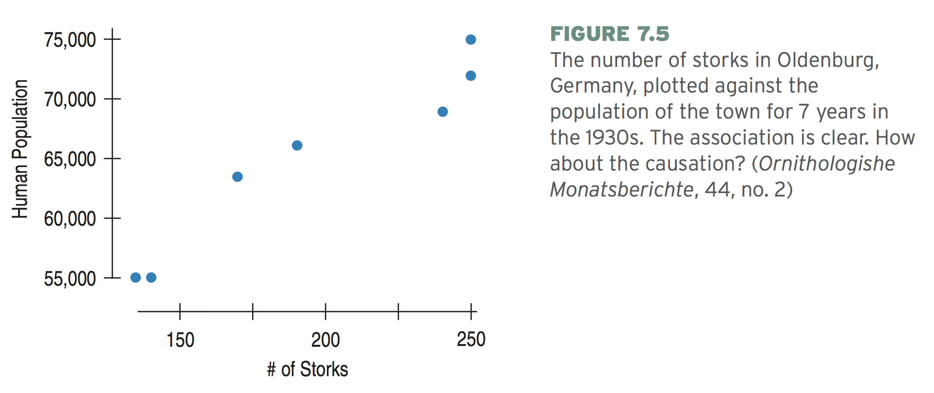
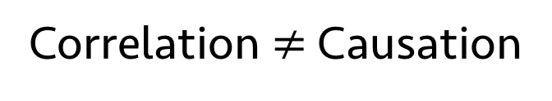
Lecture 05 | 091718
Correlation $≠$ Causation
We, as human, tend to see causes and effects in everything.
Storks → more babies!
In fact, more people → more houses → more nesting sites → more storks (the opposite direction)
Lurking variable: a hidden variable that simultaneously influences the other two variables
Scatterplots and correlation never prove causation.
CHOONG-WAN WOO | COCOAN lab | http://cocoanlab.github.io

Slide 22
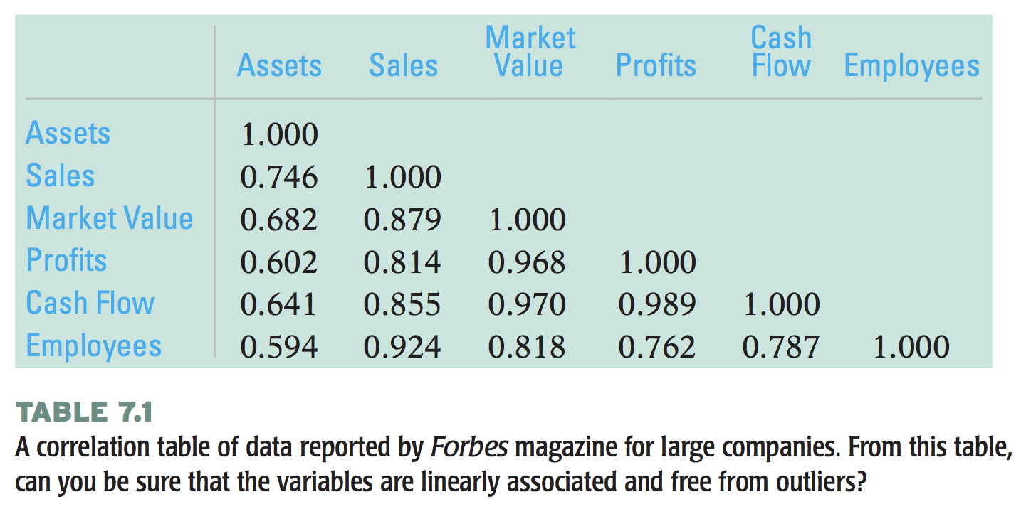
Lecture 05 | 091718
Correlation table
CHOONG-WAN WOO | COCOAN lab | http://cocoanlab.github.io

Slide 23
Lecture 05 | 091718
Assumptions and Conditions for Correlation (again)
Quantitative variables condition
Straight enough condition
No outliers condition
Outliers can distort the correlation dramatically.
What if the relationship is not straight enough (i.e., non-linear)
If the scatterplot shows a bent shape that consistently increases or decreases, we can straighten the relationship by re-expressing, or transforming, one or both variables.
CHOONG-WAN WOO | COCOAN lab | http://cocoanlab.github.io

Slide 24

Lecture 05 | 091718
Let’s take a look at JASP together!
Click “File”
CHOONG-WAN WOO | COCOAN lab | http://cocoanlab.github.io

Slide 25
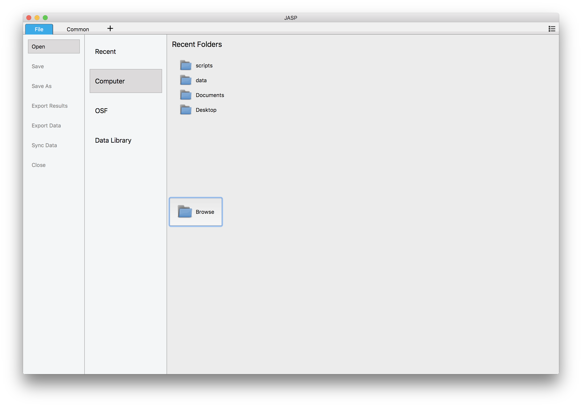
Lecture 05 | 091718
Let’s take a look at JASP together!
Click “File”
Computer-Browse
1
2
CHOONG-WAN WOO | COCOAN lab | http://cocoanlab.github.io

Slide 26
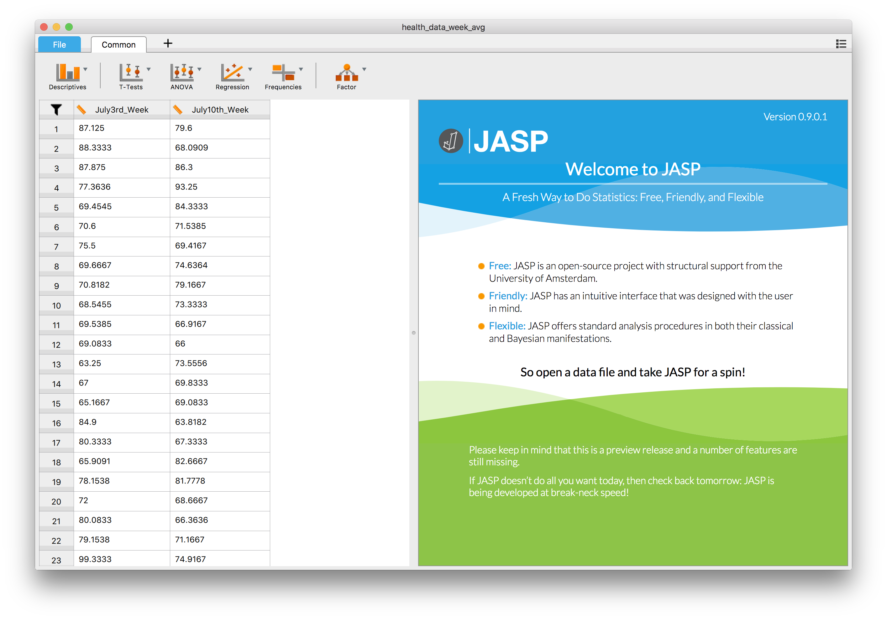
Lecture 05 | 091718
Let’s take a look at JASP together!
Select: “health_data_week_avg.csv” file in the data folder
CHOONG-WAN WOO | COCOAN lab | http://cocoanlab.github.io

Slide 27
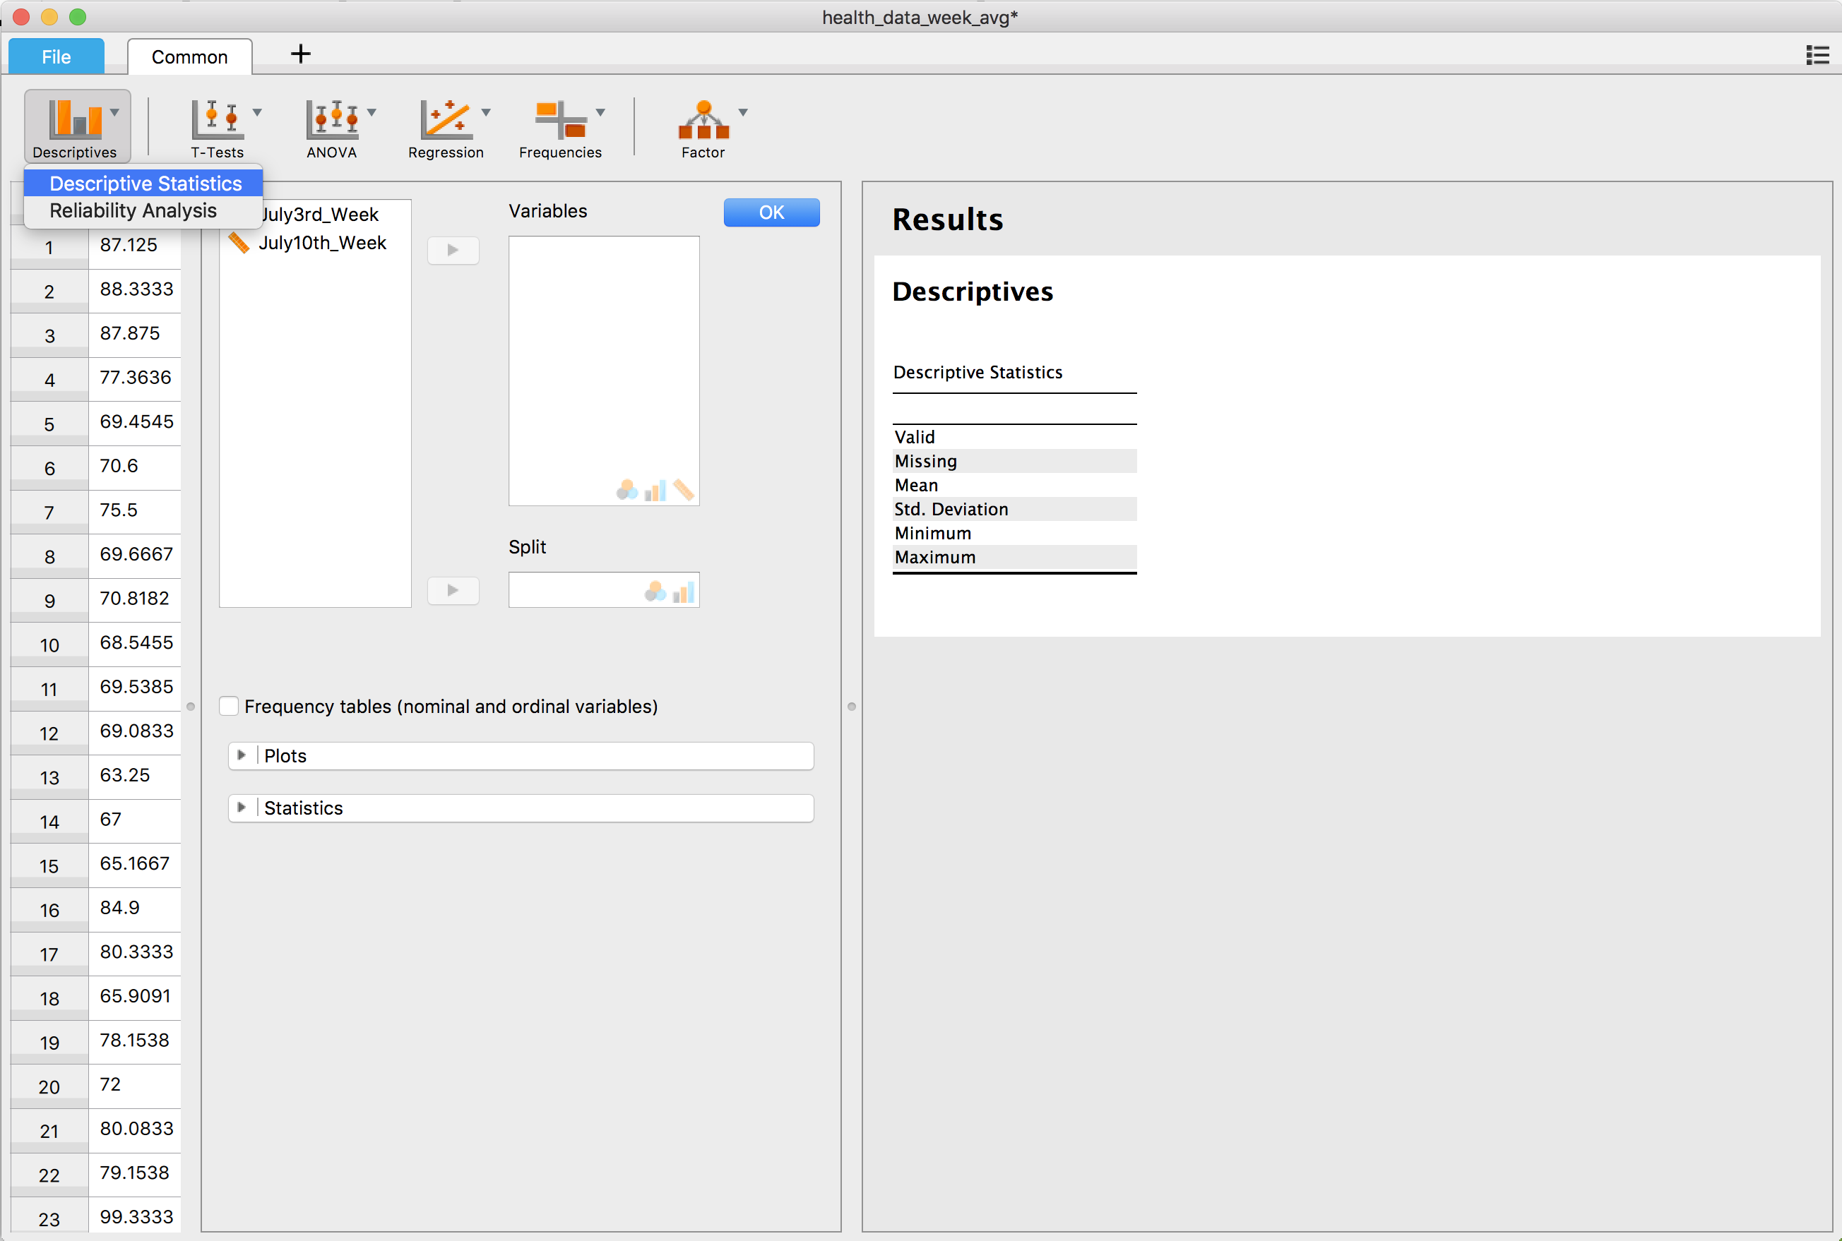
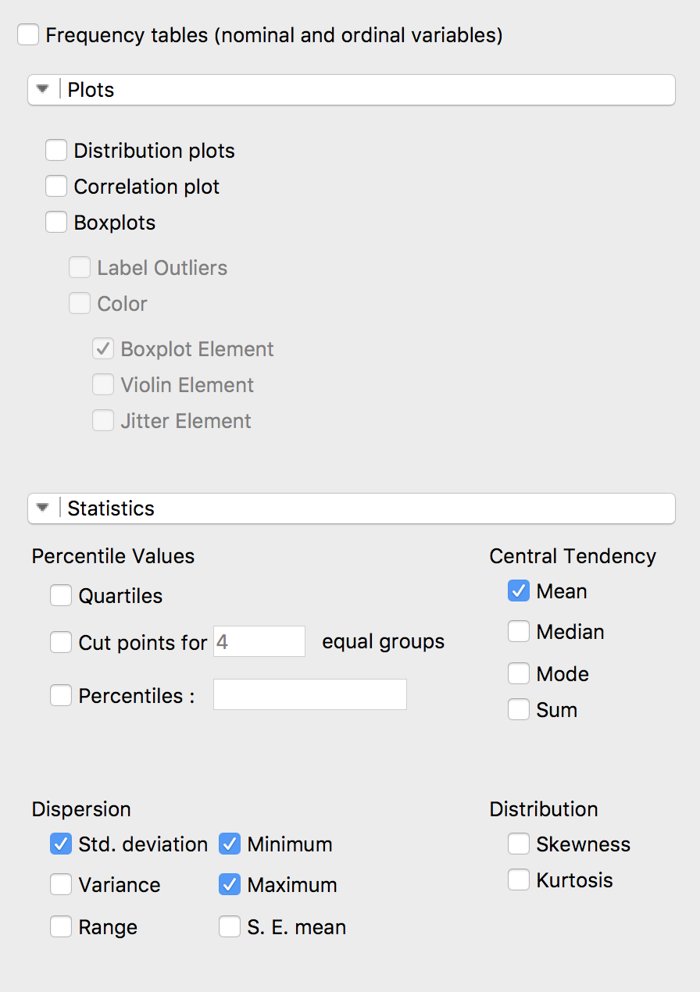
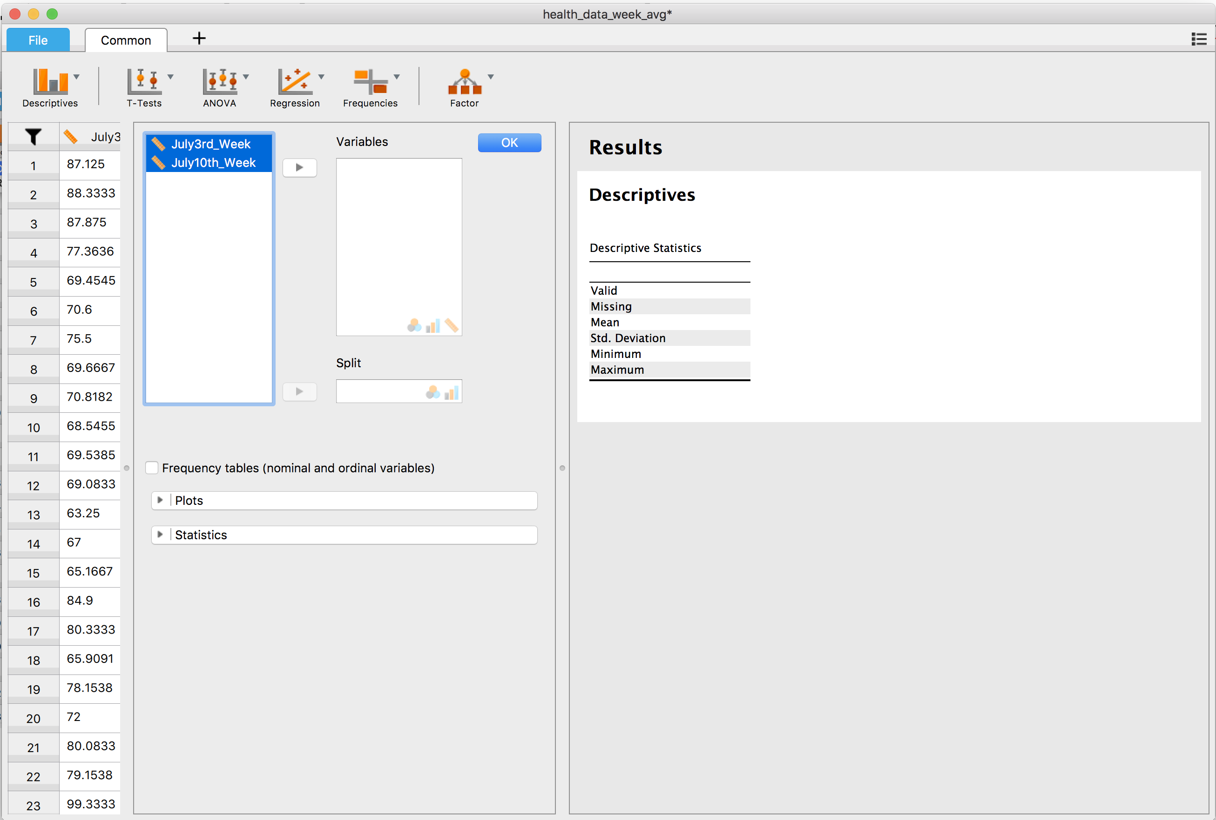
Lecture 05 | 091718
Let’s take a look at JASP together!
Select: “health_data_week_avg.csv” file in the data folder
In the menu, you can click whatever you want!
CHOONG-WAN WOO | COCOAN lab | http://cocoanlab.github.io

Slide 28
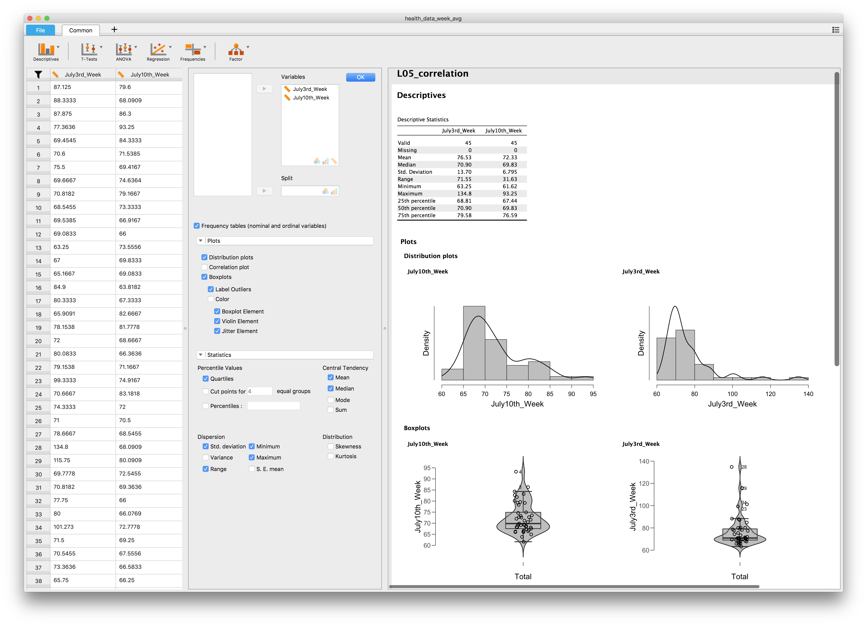
Lecture 05 | 091718
Let’s see the results:
Descriptive statistics
CHOONG-WAN WOO | COCOAN lab | http://cocoanlab.github.io

Slide 29
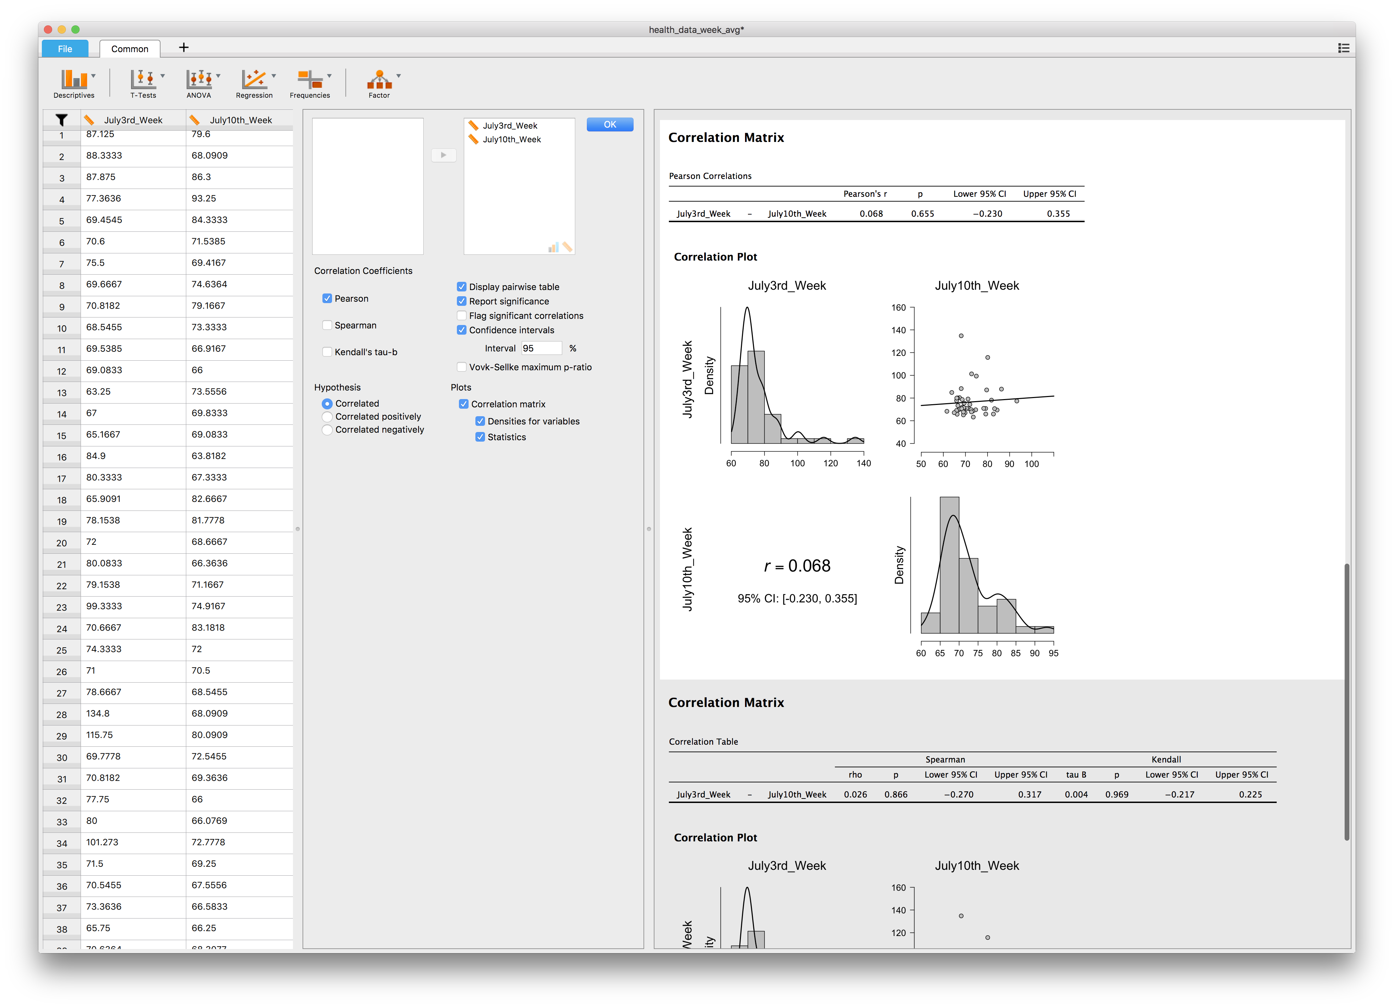
Lecture 05 | 091718
Let’s see the results:
Correlation:
Pearson’s correlation
CHOONG-WAN WOO | COCOAN lab | http://cocoanlab.github.io

Slide 30
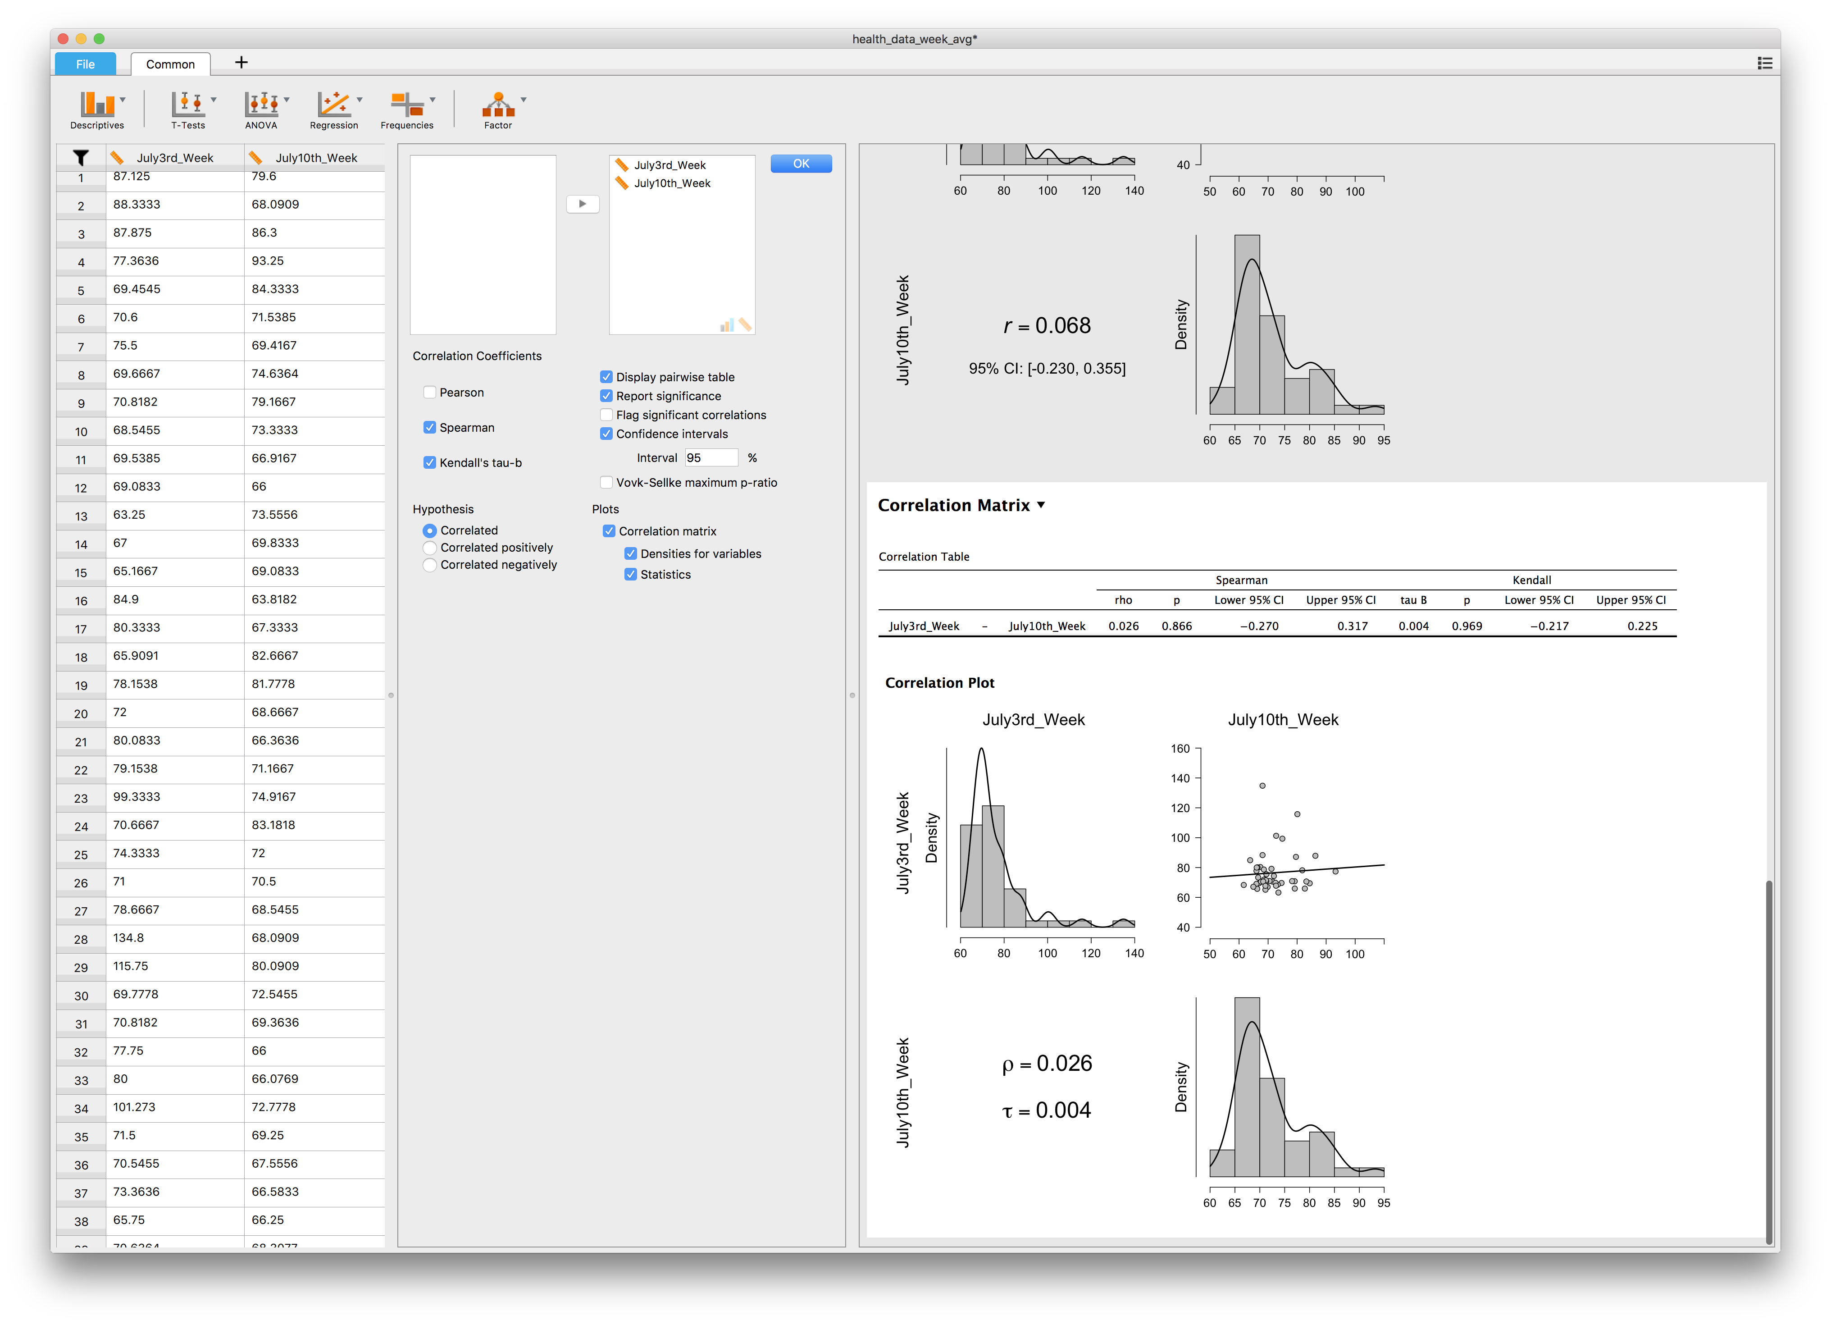
Lecture 05 | 091718
Let’s see the results:
Correlation:
1) Spearman
2) Kendall’s tau-b
CHOONG-WAN WOO | COCOAN lab | http://cocoanlab.github.io

Slide 31
Lecture 05 | 091718
Key Points
Chapter 7: Scatterplots, Correlation
Scatterplots (direction, form, strength, outliers)
x- and y-variables: explanatory/independent vs. response/dependent variables
Correlation: strength and direction
Assumptions and conditions:
Quantitative variables condition
Straight enough condition
No outliers condition
Non-parametric correlations: Kendall’s tau, Spearman’s rho
Correlation ≠ Causation
Correlation table/matrix
Next class: Chapter 8: Linear regression!
CHOONG-WAN WOO | COCOAN lab | http://cocoanlab.github.io

